Slide 1
Department of Research
& Graduate Studies
EMA 5104: Methods of Teaching Mathematics at the Secondary Level
Lecture Notes: 1
Lecturer: Peter Wintz
Semester 1: 2026

Slide 2
Common Mistakes Teachers Make
Belittling
Humiliating
Criticising
Fault-finding
Threatening

Slide 3
Common Mistakes Teachers Make
Mortification
Neglect/Disregard
Pampering
Instilling fear & anxiety
Nagging
Physical punishment

Slide 4
Children Respond To:
Consistency
Flexibility
Fairness
Natural confidence
Love and affection
Respect
Attention

Slide 5
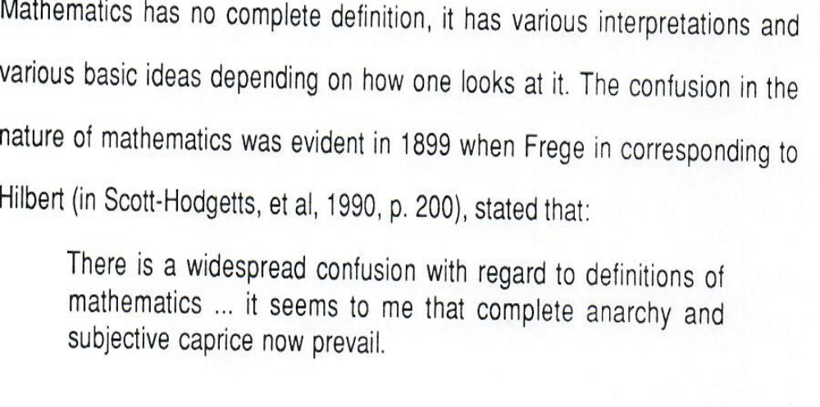
What is Mathematics?

Slide 6
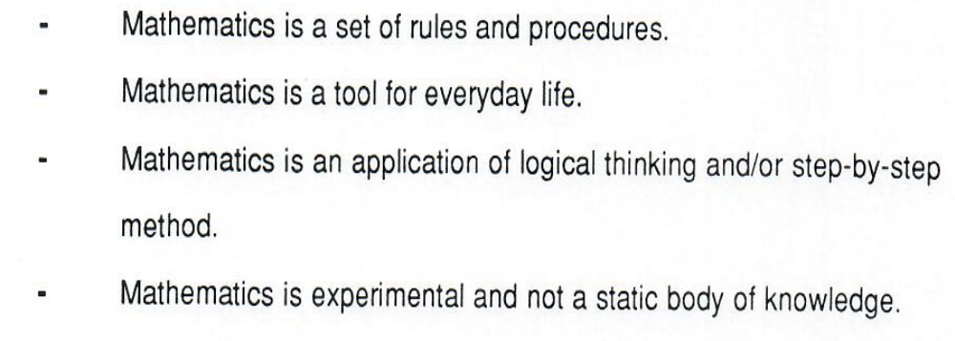

What is Mathematics?

Slide 7
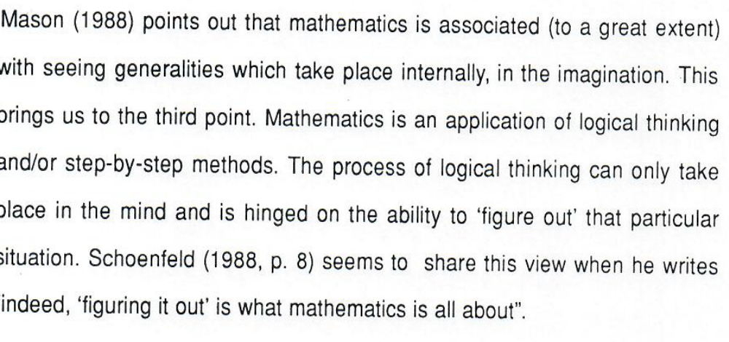

Slide 8
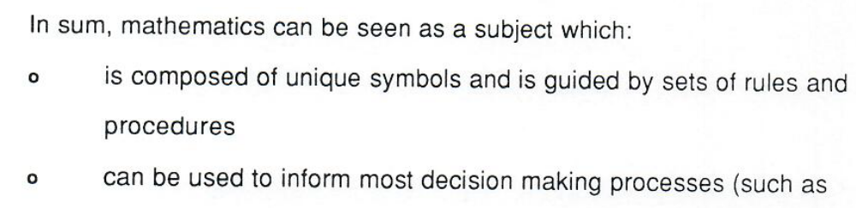
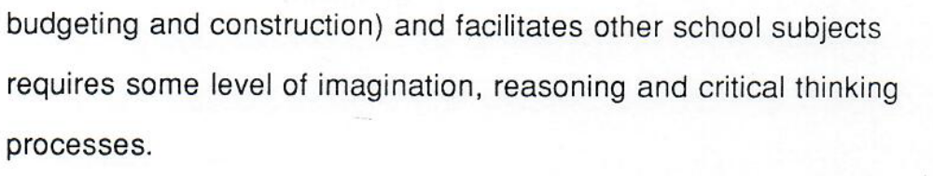
What is Mathematics?

Slide 9
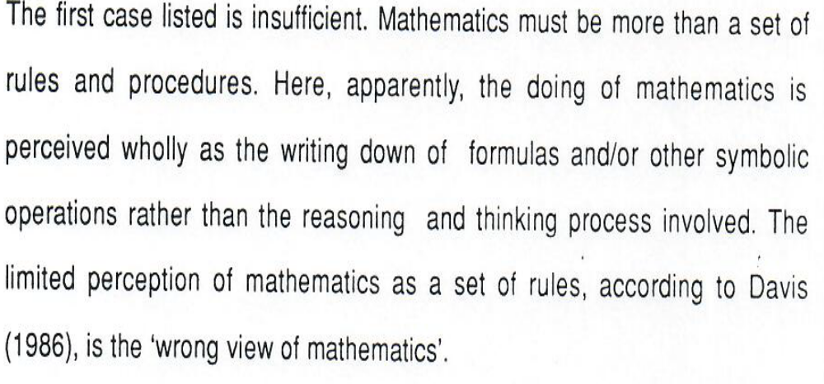

Slide 10
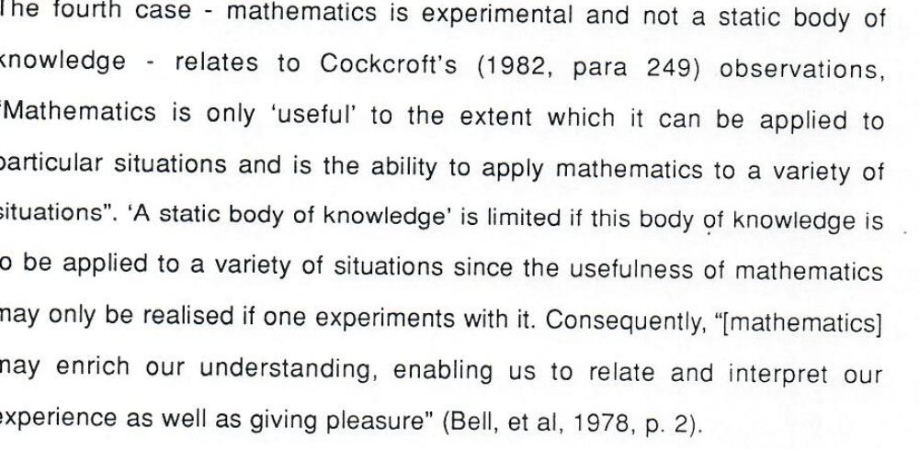

Slide 11
What does it mean to learn Mathematics?

Slide 12
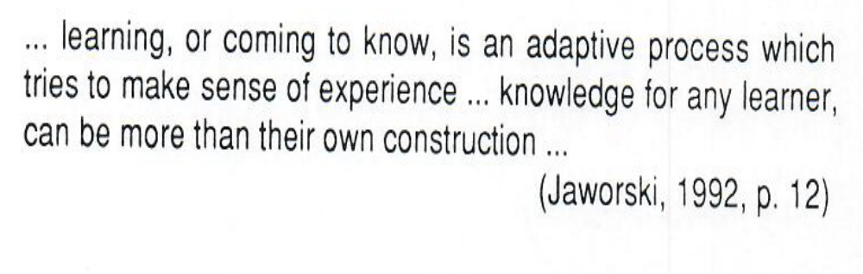
What does it mean to learn Mathematics?

Slide 13
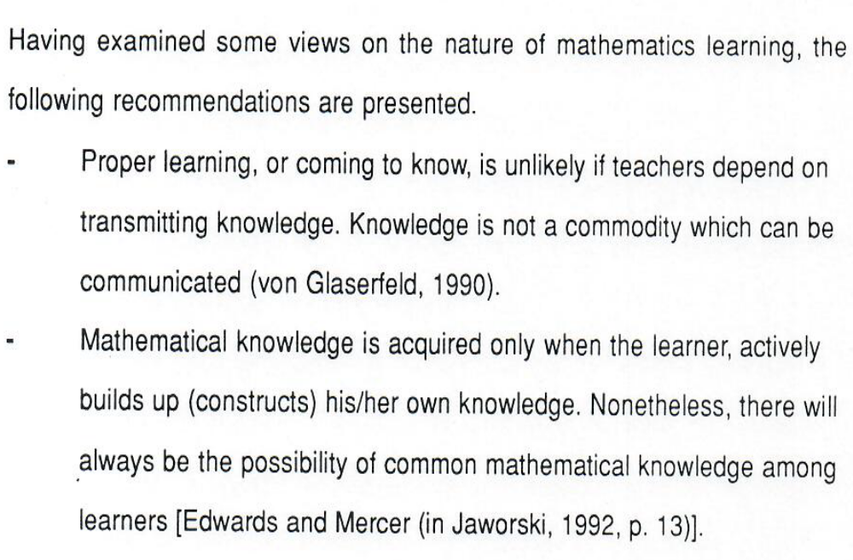
What does it mean to learn Mathematics?

Slide 14
END

